Slide 1
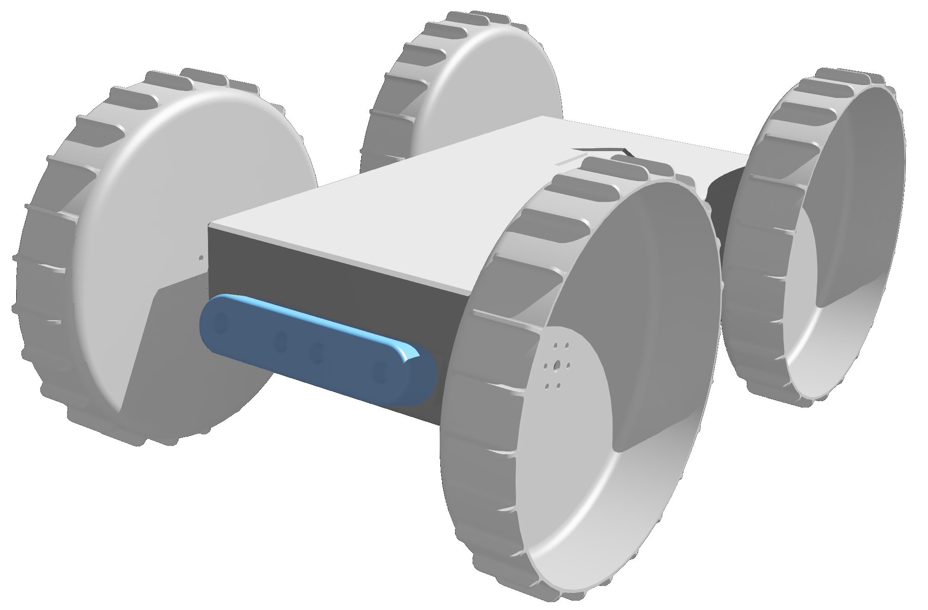














Z
R₁
Obstacle
Threshold
Obstacle
Zone
Punishment
Zone
Y
X

Slide 2


Irrelevant Region
Region of Interest
Irrelevant Region

